Slide 1

VIRTUAL DATA ANALYTICS INTERNSHIP PROGRAM
BY
YAMINI MANOHARAN

Slide 2
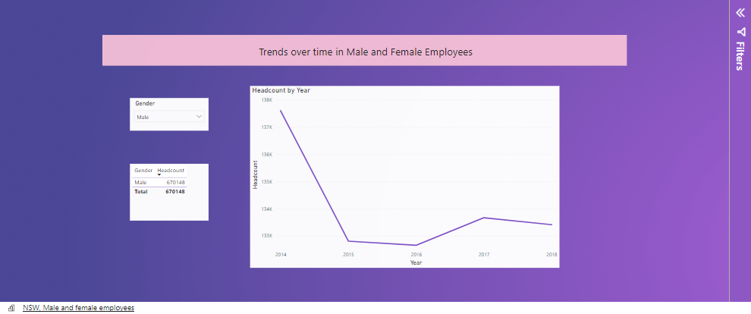
From the above visualization, we can say that the employment of female has increased over years and employment of male has decreased over time from 2014 to 2015.

Slide 3
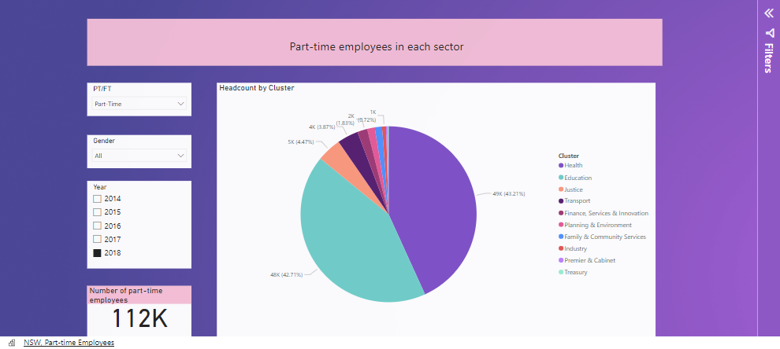
The above visualization shows the number of part-time employees working in each sector.

Slide 4
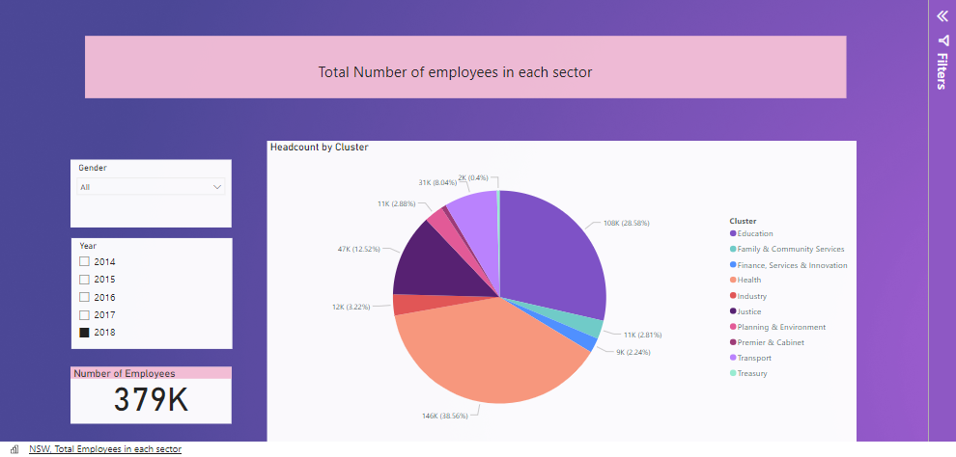
The above visualization shows the total number of employees working in each sector from the year 2014-2018.

Slide 5
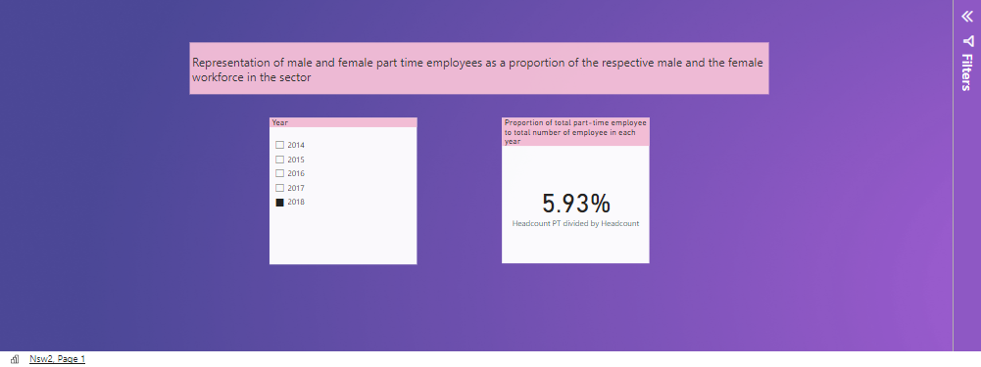
The proportion of total male and female part-time employees to the total male and female employees in the sector is about 5.39% to 5.93%
We can say that the number of part-time employee is less in number when compared to number of full-time employees.

Slide 6
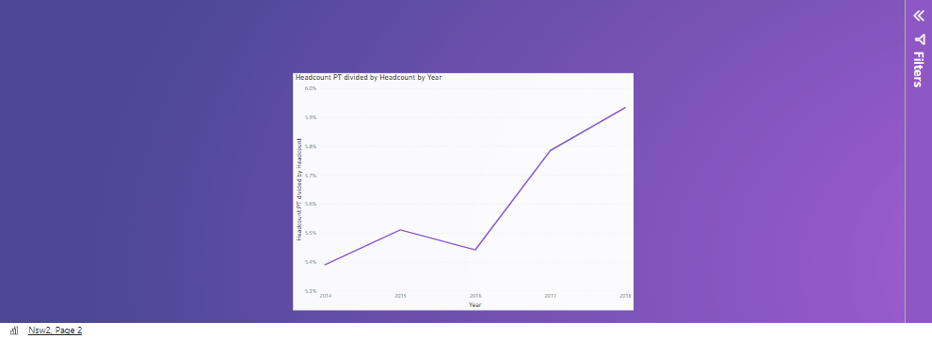
The above graph shows that the number of part-time employees has increased from 102k to 112k from the year 2014-2018. At the same time, the number of employees working full-time remains the same.
If this trend continues, the number of part-time employees will increase with time and in the year 2025 the number of employee will increase significantly compared to number of full-time employees.

